Slide 1

Never
Spyre
Arcanist
Spyre
Royal Level
Noble
Spyre
Throne Level
Temple
Of
Tyr
Entrance Level
Dungeon Level
Never Death

Slide 2
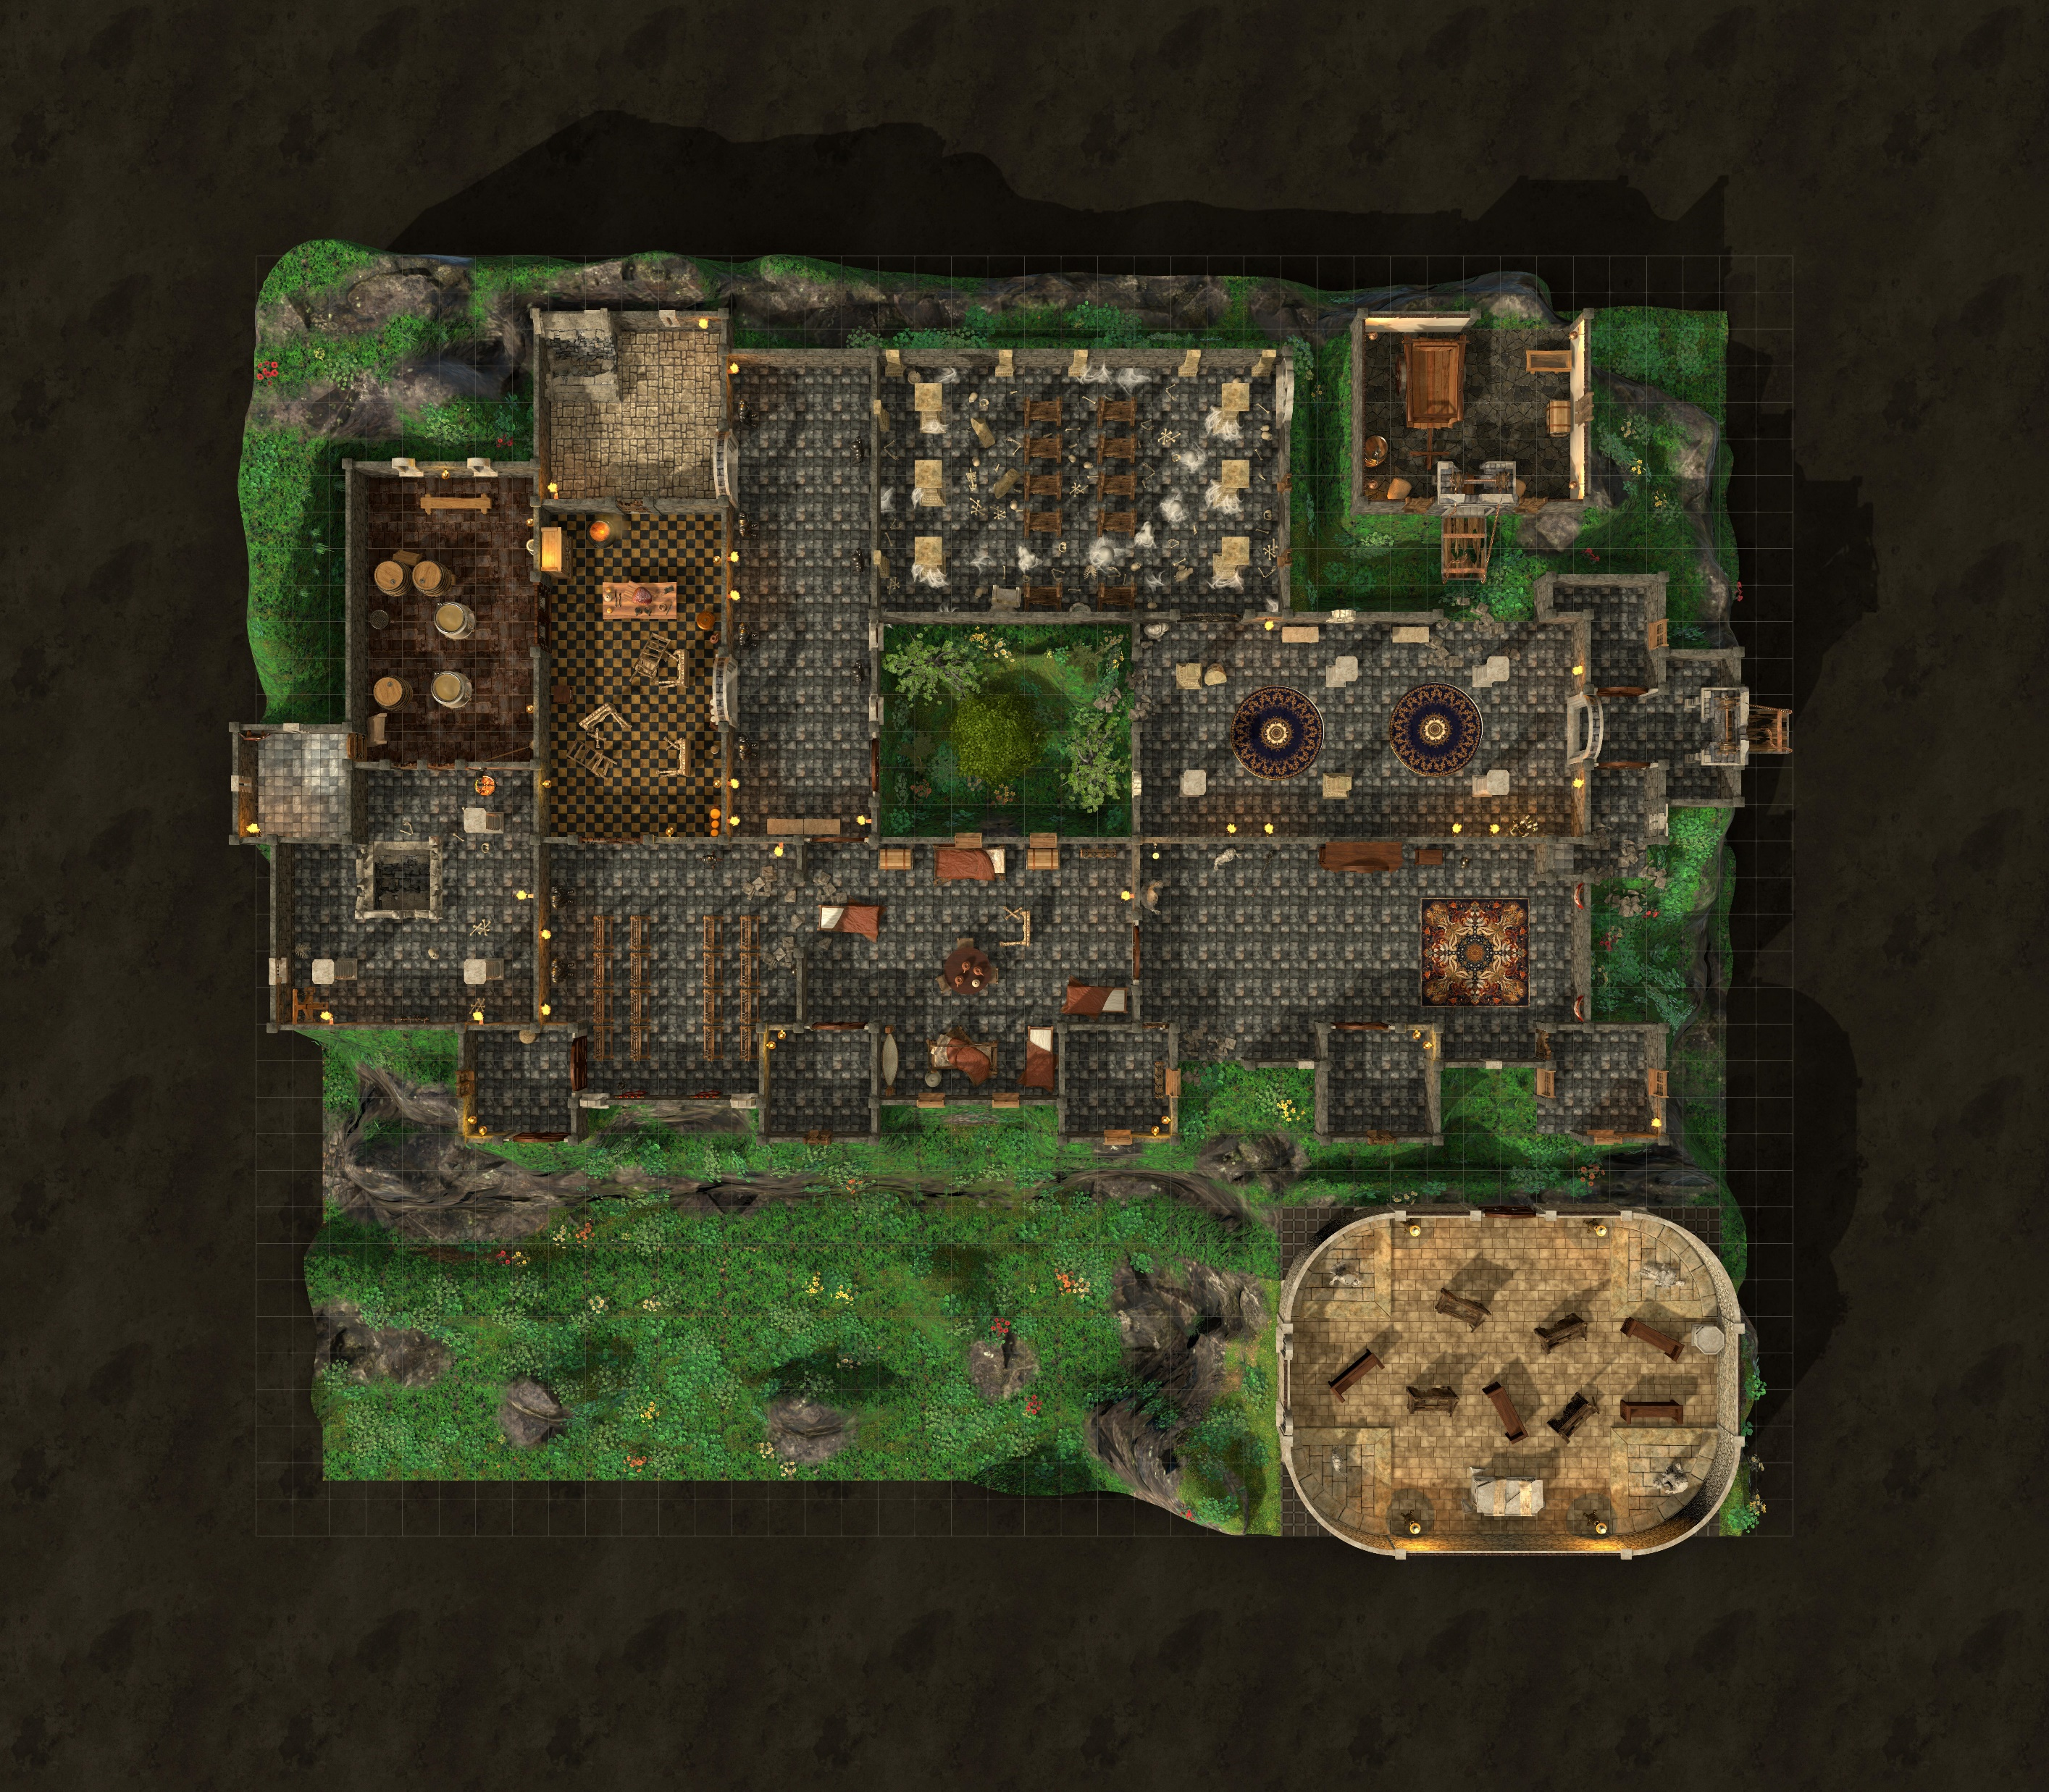
13
11
7
Shield
Guardian
5
14
12
8
2
Shield
Guardian
3
1
2
15
10
9
4
2
2
2
2
2
16
6
Arcane
Lift
Temple of Tyr

Slide 3
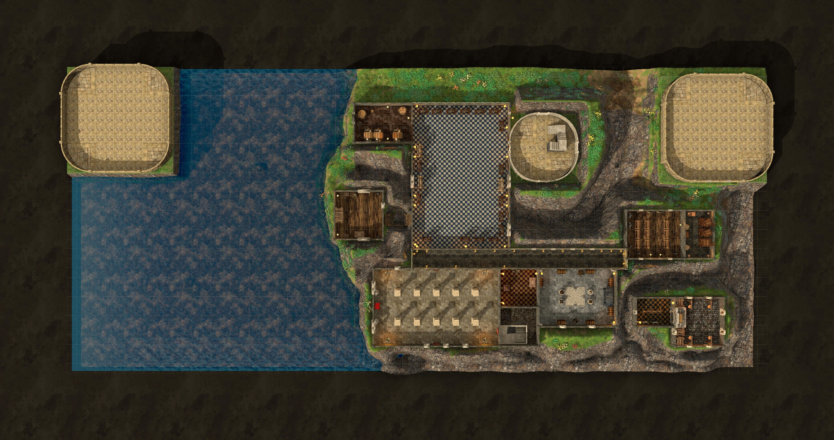
Noble Spire
Arcanist Spyre
Hall of Mirrors
Arcane
Lift
Throne Room
Lesser
Treasure
Room
Stewards Quarters

Slide 4
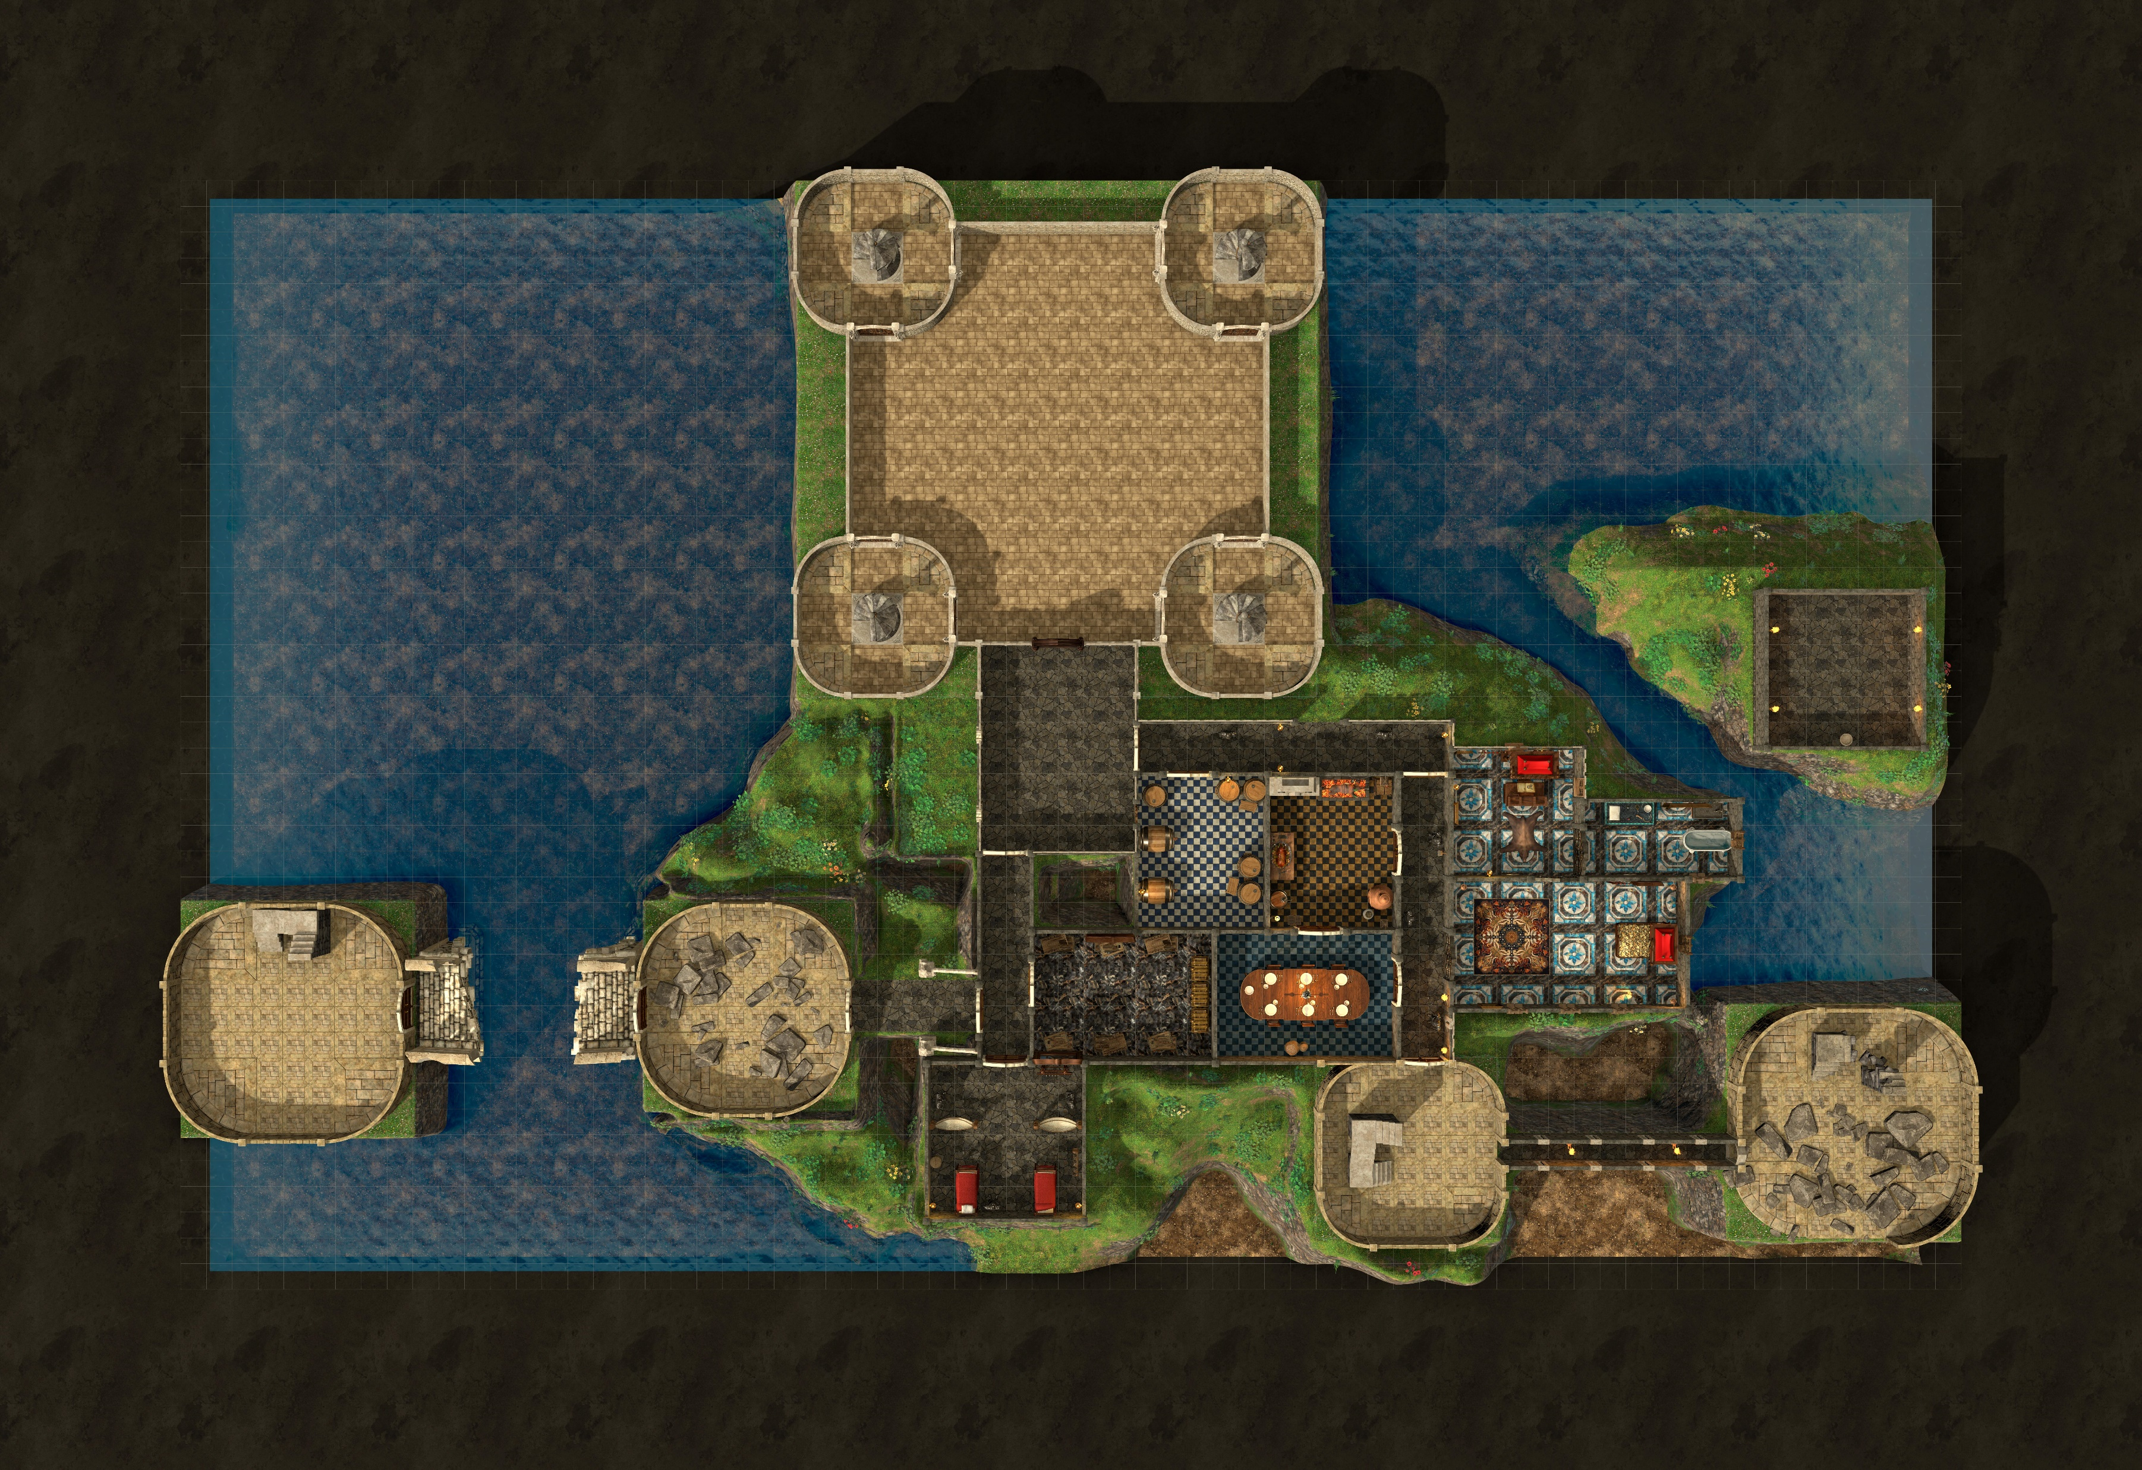
Never Spyre
Suite
Royal
Study
Royal
Bath
Royal
Kitchen
Royal
Chamber
Royal
Treasure
Room
Royal
Dining Hall
Arcanists Spyre
Arcane
Lift
Noble Spyre
Royal
Guards
Watch

Slide 5
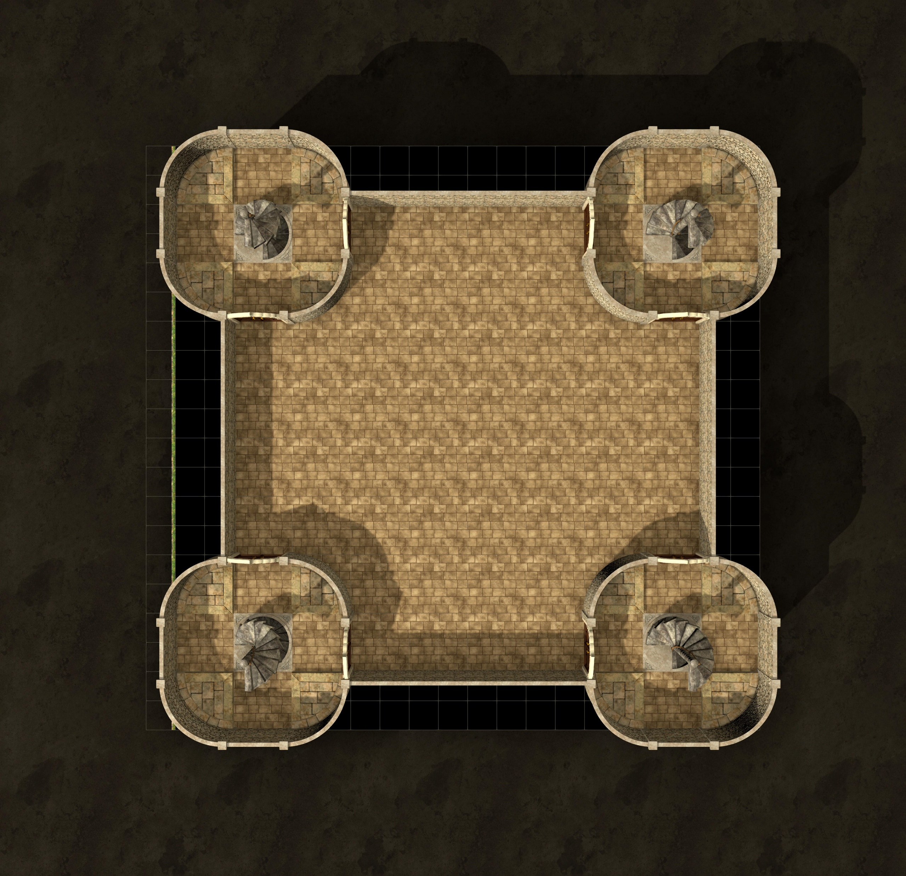

Slide 6
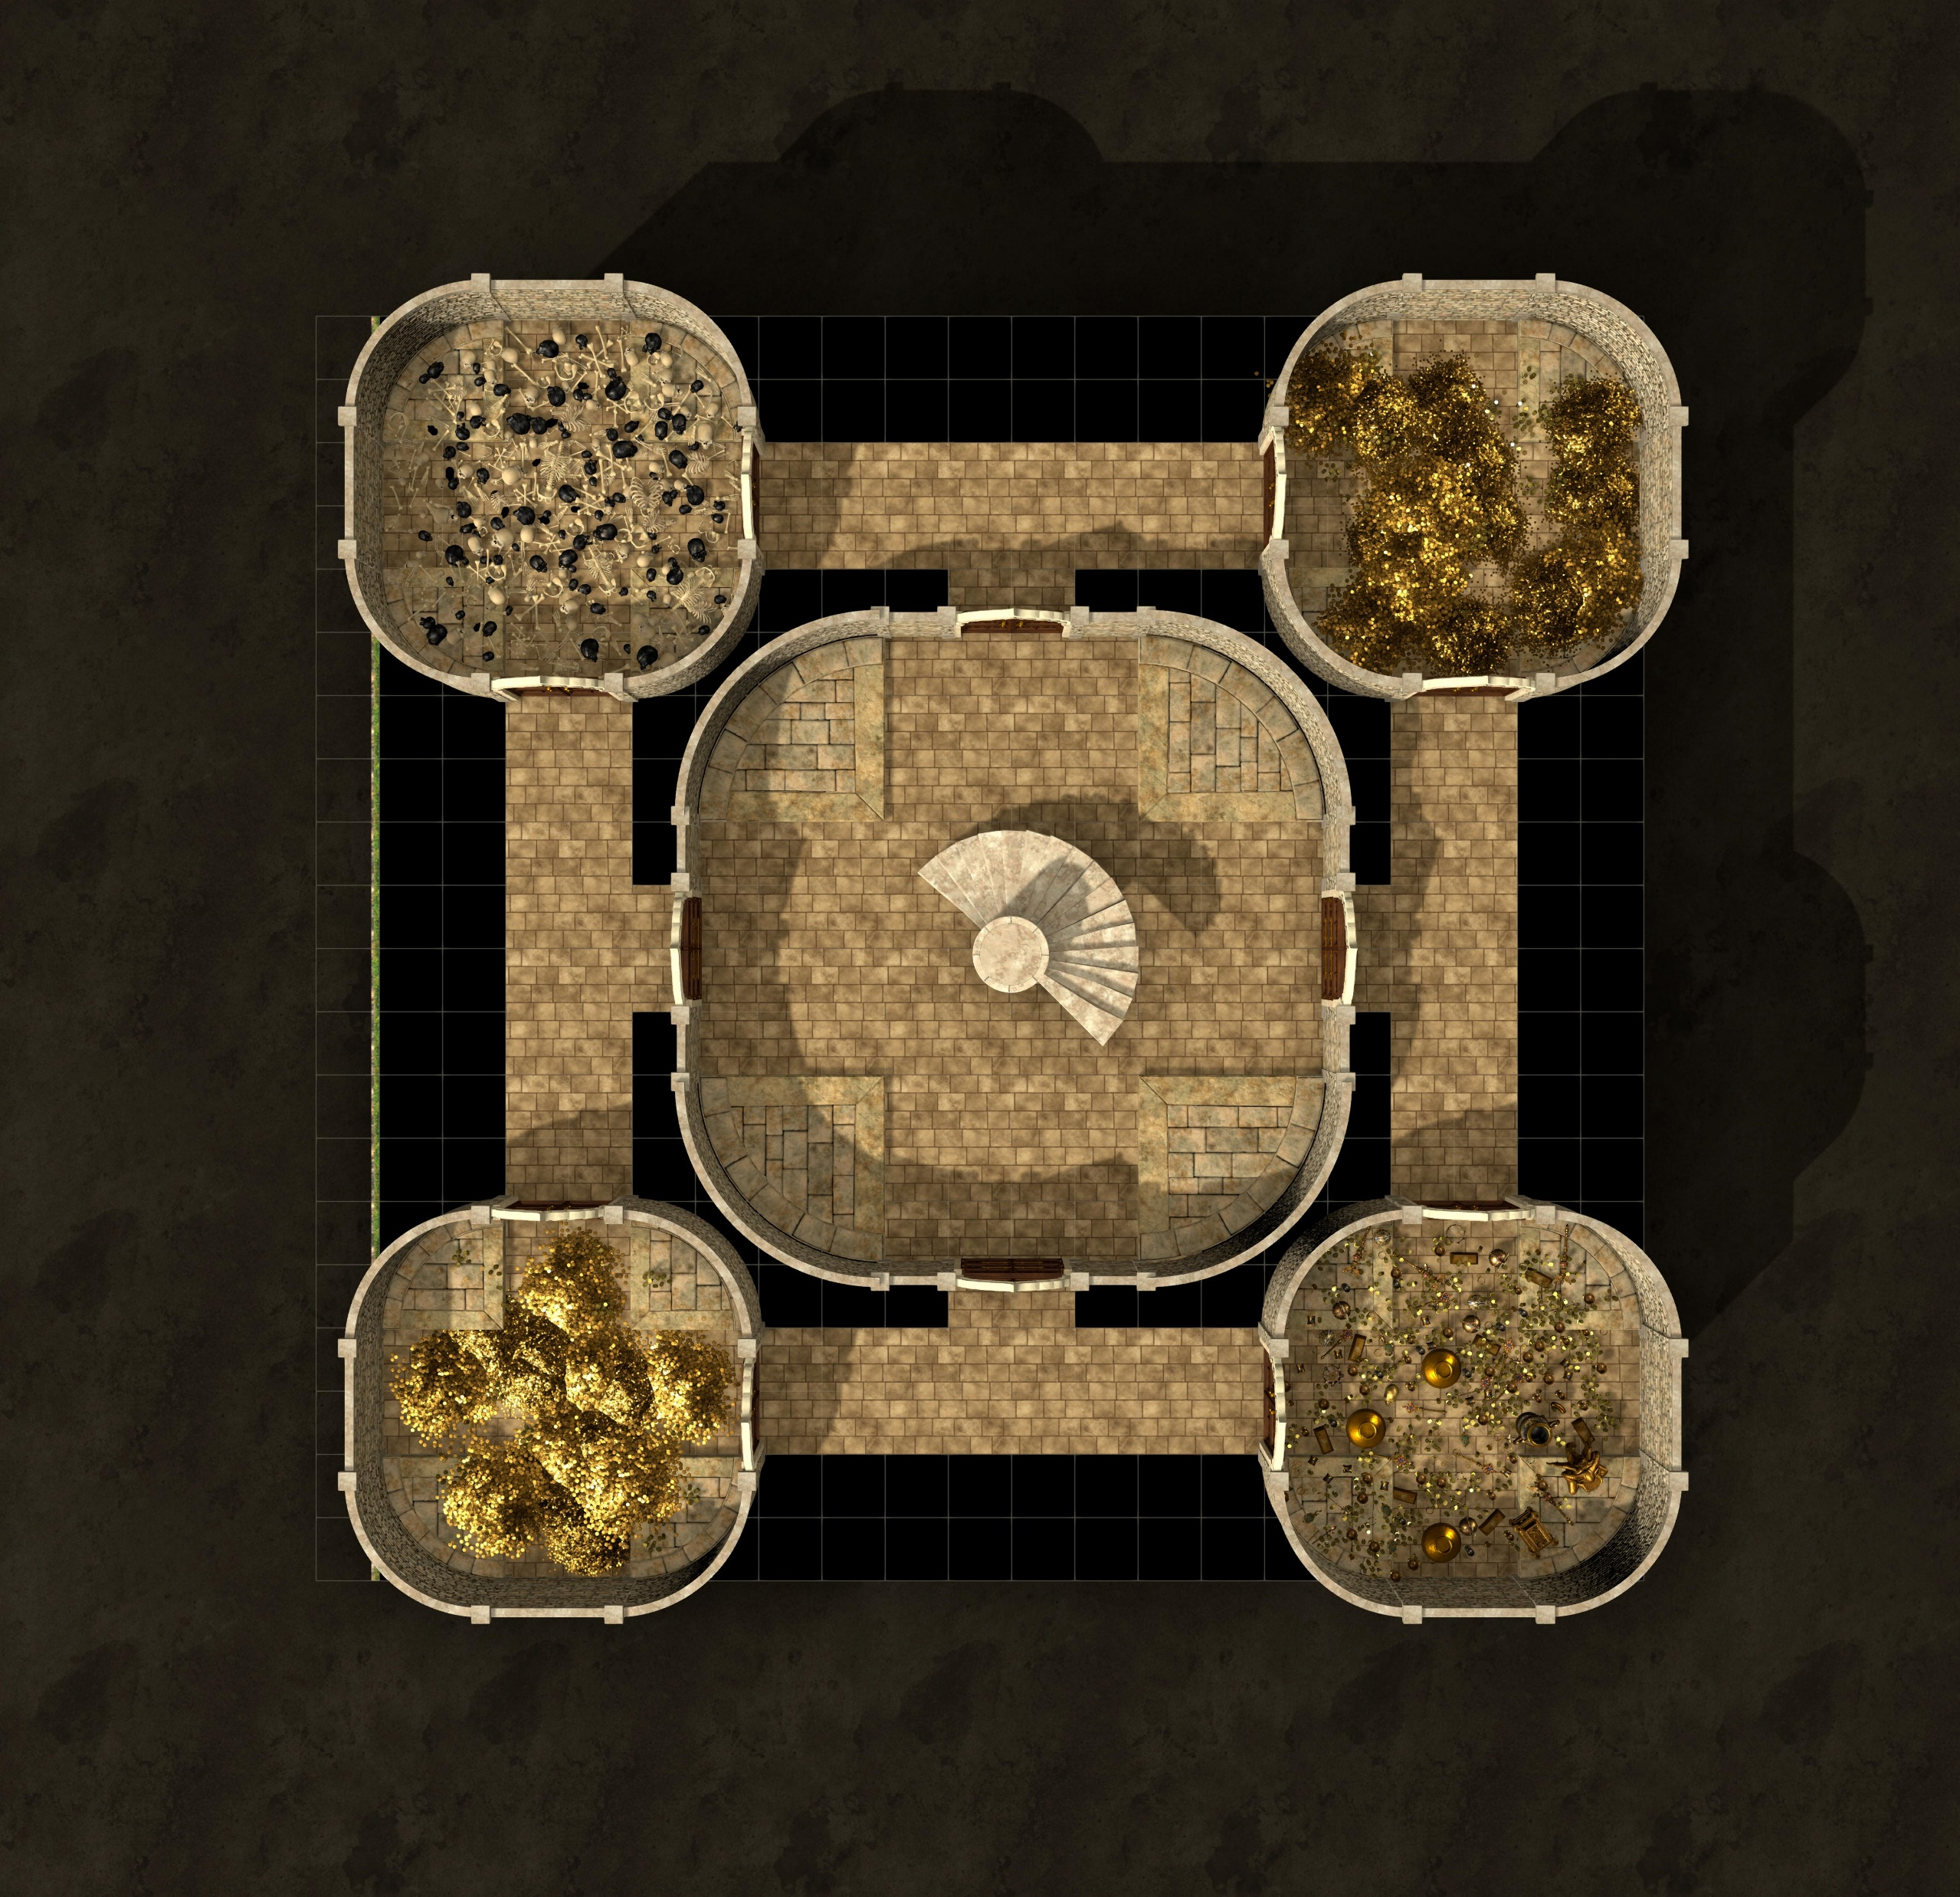

Slide 7
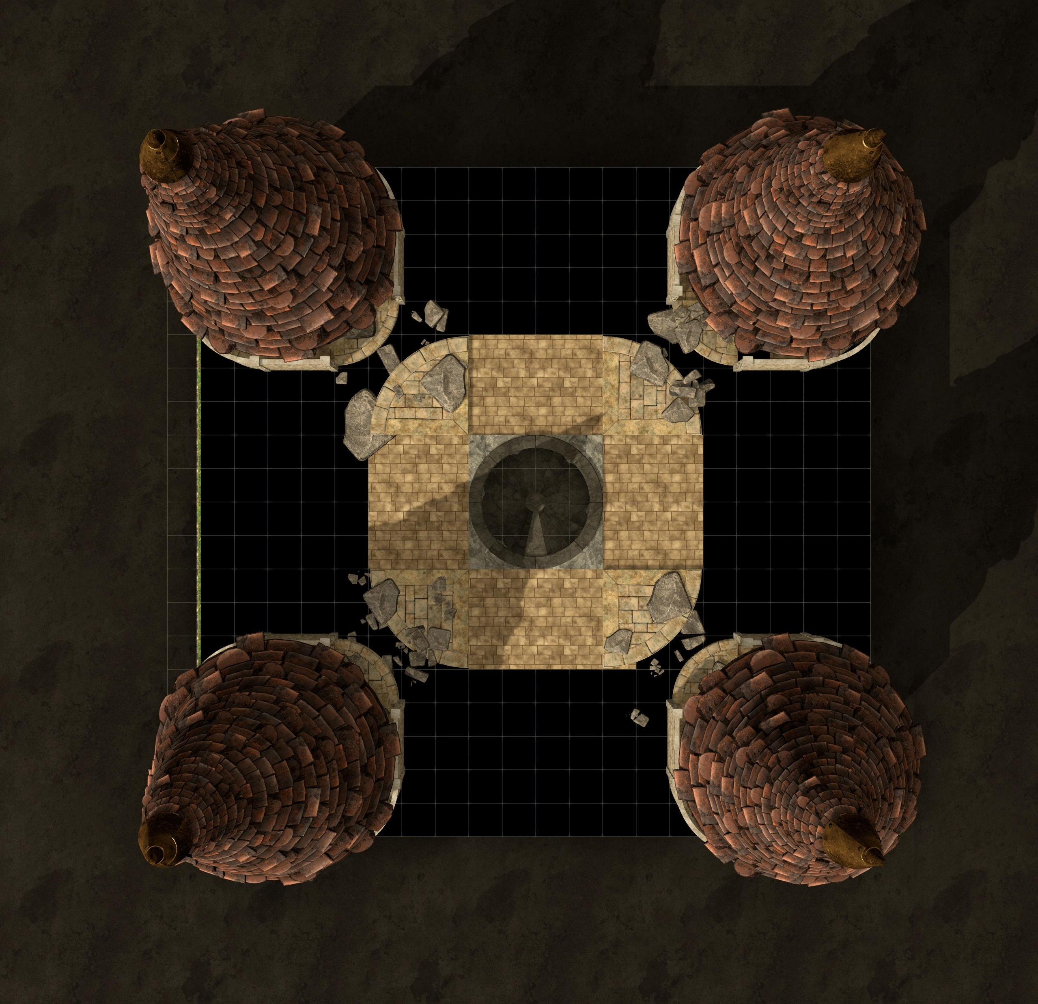

Slide 8
